Slide 1

Python Assignment: Bank Customer Churn Prediction
By Amit Pant- 07
Neha Singhal - 25

Slide 2

What & why are we solving this problem!
What is this dataset?
This bank’s dataset comprises of various attributes of their customers?
Why this dataset?
We aim to accomplish the following for this study:
Identify and visualize which factors contribute to customer churn.
Build a prediction model that will perform the following:
Classify if a customer is going to churn or not
Preferably and based on model performance, choose a model that will attach a probability to the churn to make it easier for customer service to target low hanging fruits in their efforts to prevent churn

Slide 3
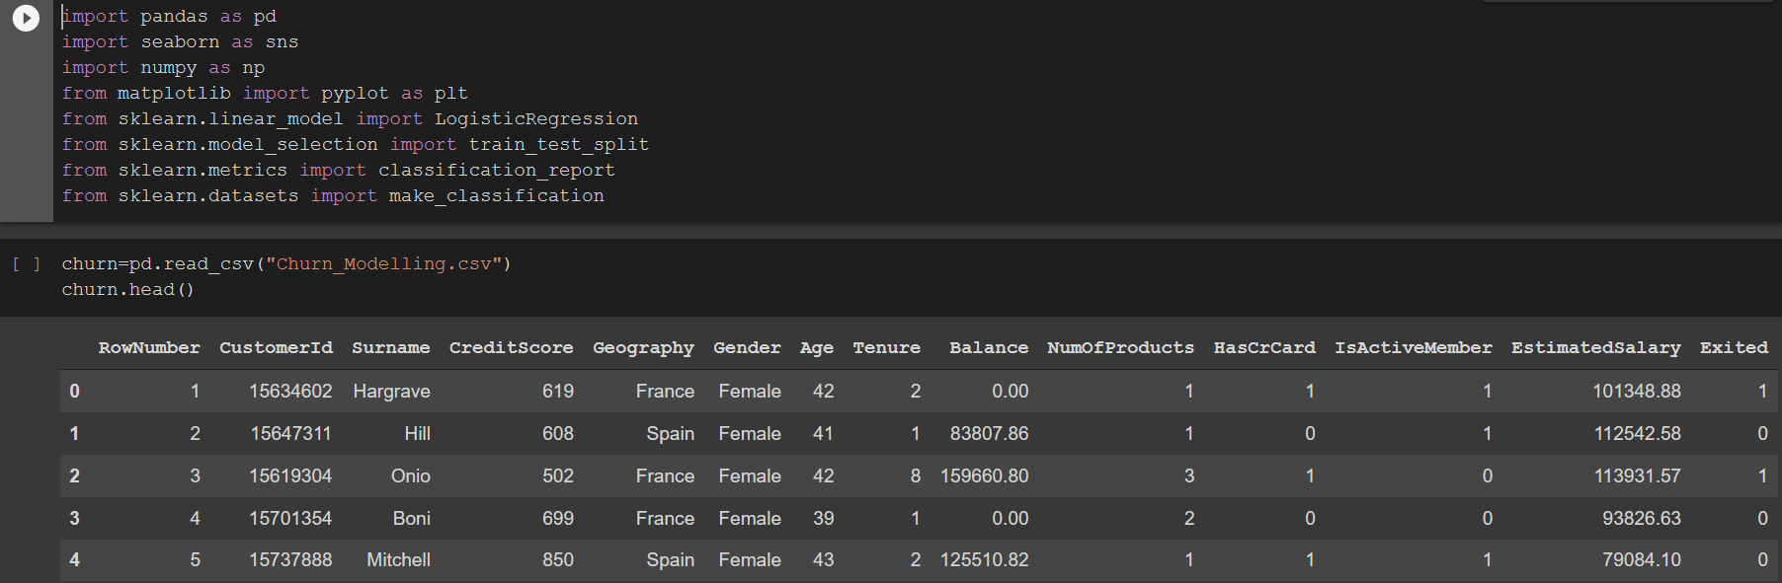
INITIAL ANALYSIS OF THE DATASET
In this section we will seek to explore the structure of our data:
To understand the input space the data set
And to prepare the sets for exploratory and prediction tasks

Slide 4
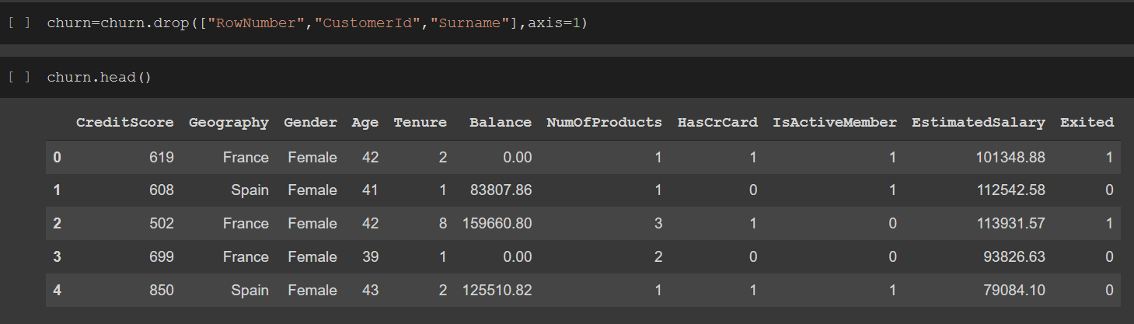
DROPPING UNNECESSARY COLUMNS

Slide 5
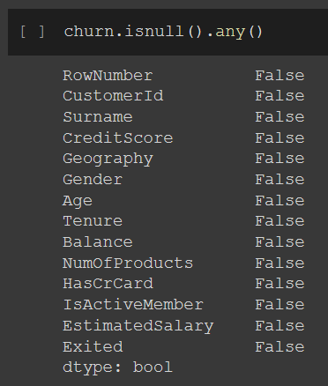
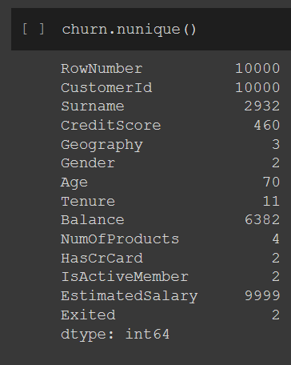
CHECKING THE NULL VALUES AND NUMBER OF UNIQUE COLUMNS

Slide 6
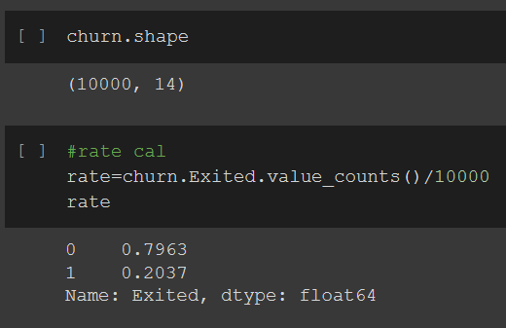
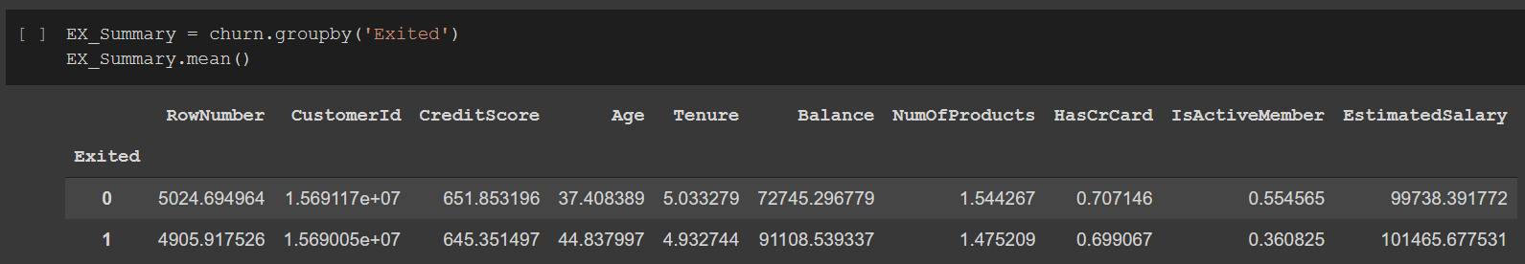
Churn Rate calculation
For reference-
0= no of customers retained
1= no of customers leaving the organinsation

Slide 7
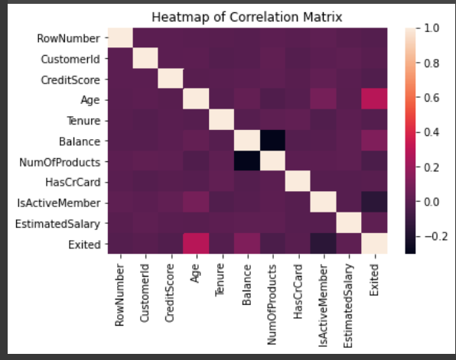
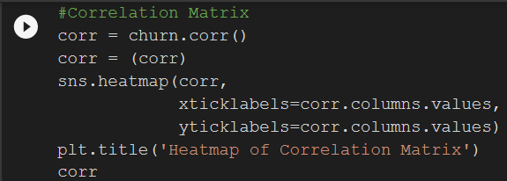
CORRELATION HEAT MAP

Slide 8
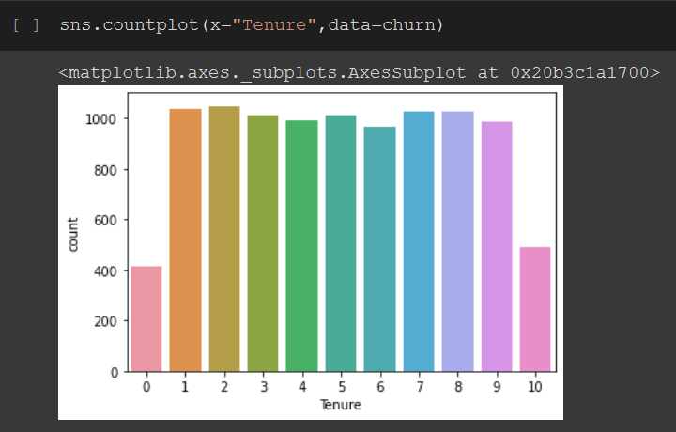
Exploratory data analysis
In this section we will seek to explore the structure of our data: To understand the input space the data set and to prepare the sets for exploratory and prediction task

Slide 9
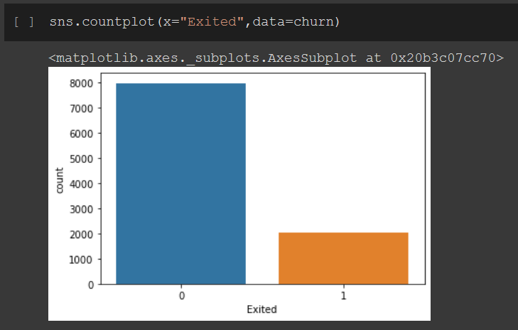
EDA CONTINUED
For reference-
0= no of customers retained
1= no of customers leaving the organinsation

Slide 10
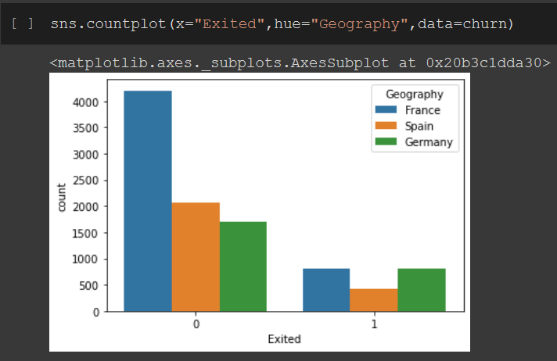
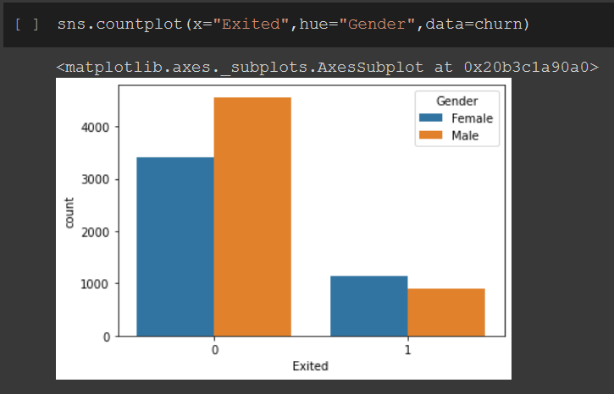
EDA CONTINUED
For reference-
0= no of customers retained
1= no of customers leaving the organinsation
For reference-
0= no of customers retained
1= no of customers leaving the organinsation

Slide 11
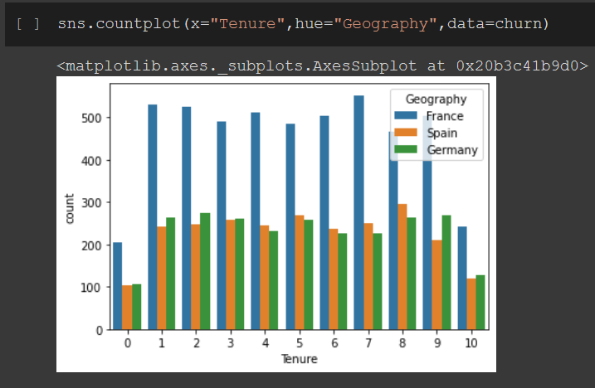
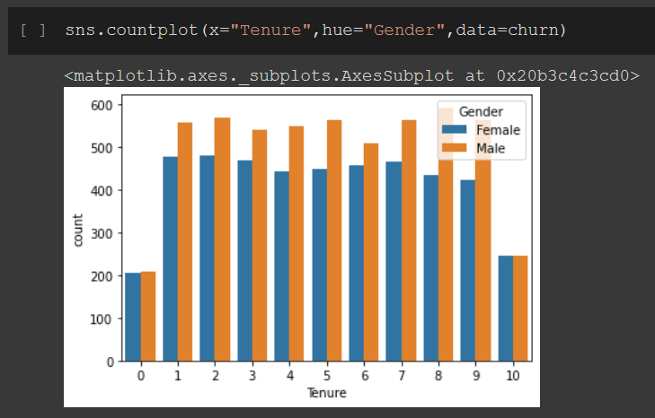
EDA CONTINUED

Slide 12
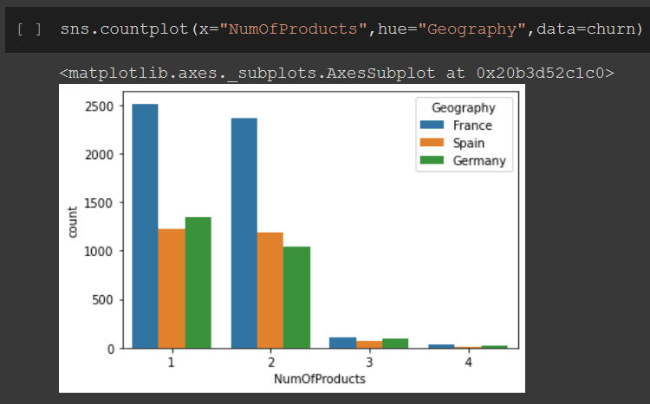
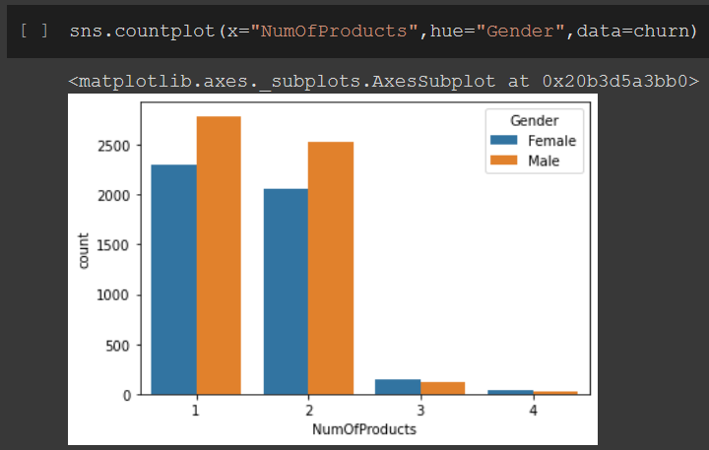
EDA CONTINUED

Slide 13
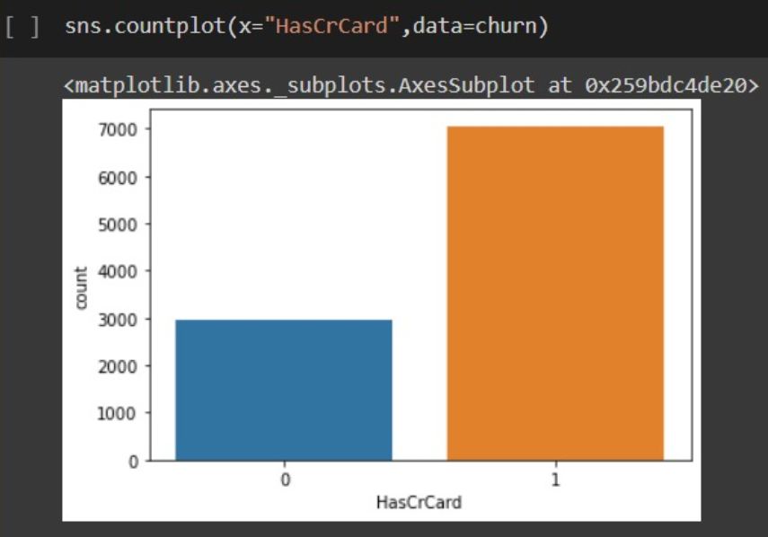
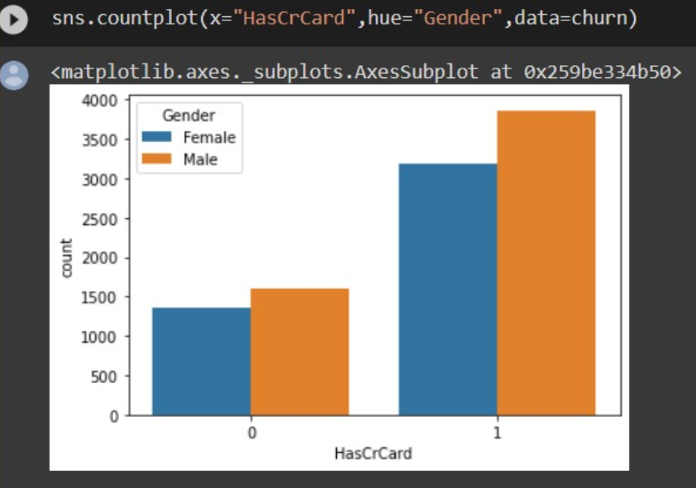
EDA CONTINUED
For reference-
0= no of customers has credit card
1= no of customers not having credit card
For reference-
0= no of customers has credit card
1= no of customers not having credit card

Slide 14
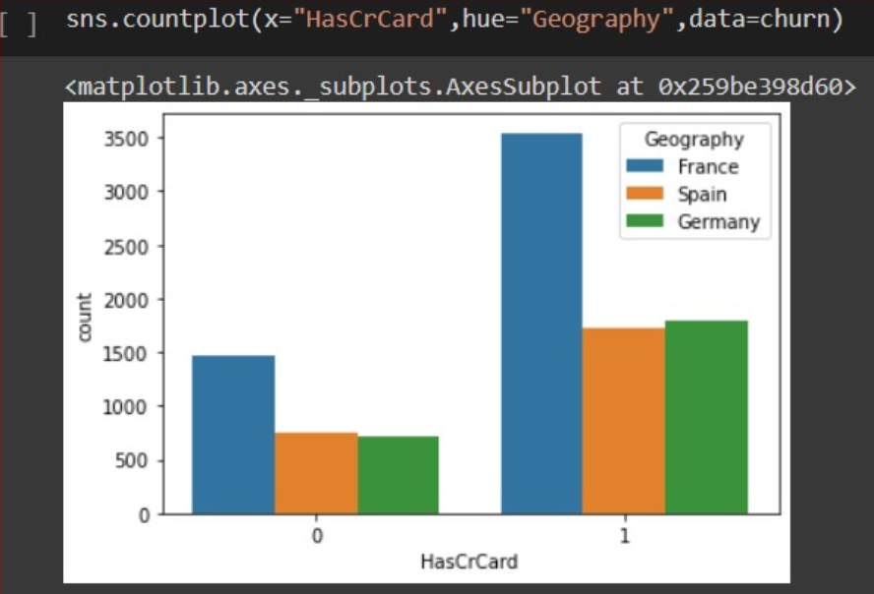
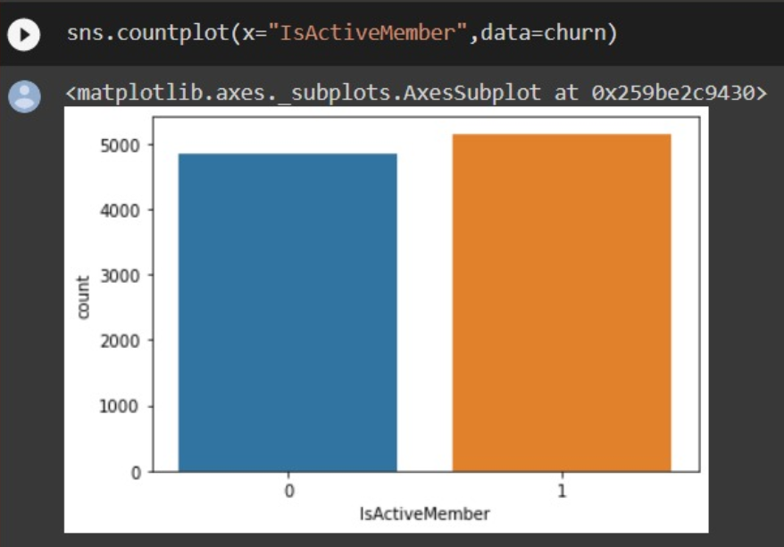
EDA CONTINUED
For reference-
0= no of customers has credit card
1= no of customers not having credit card
For reference-
0= no of customers has active members
1= no of customers not having active members

Slide 15
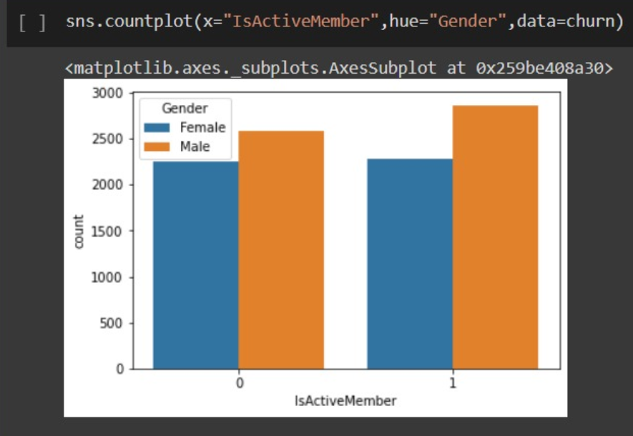
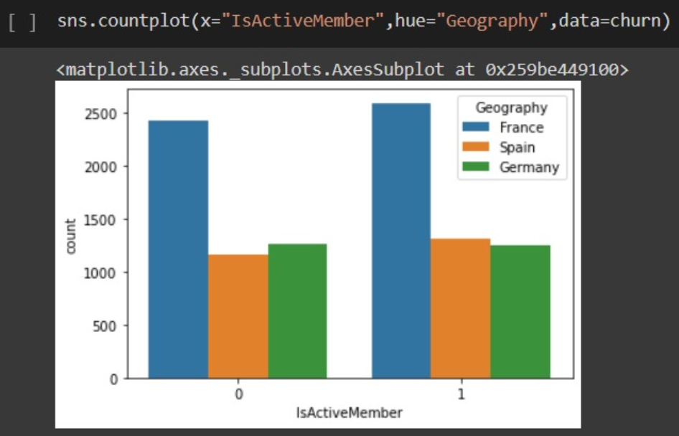
EDA CONTINUED
For reference-
0= no of customers has active members
1= no of customers not having active members
For reference-
0= no of customers has active members
1= no of customers not having active members

Slide 16
Insights from EDA
Majority of the data is from persons from France. However, the proportion of churned customers is with inversely related to the population of customers alluding to the bank possibly having a problem (maybe not enough customer service resources allocated) in the areas where it has fewer clients.
The proportion of female customers churning is also greater than that of male customers
Interestingly, majority of the customers that churned are those with credit cards. Given that majority of the customers have credit cards could prove this to be just a coincidence.
Unsurprisingly the inactive members have a greater churn. Worryingly is that the overall proportion of inactive members is quite high suggesting that the bank may need a program implemented to turn this group to active customers as this will definitely have a positive impact on the customer churn.

Slide 17
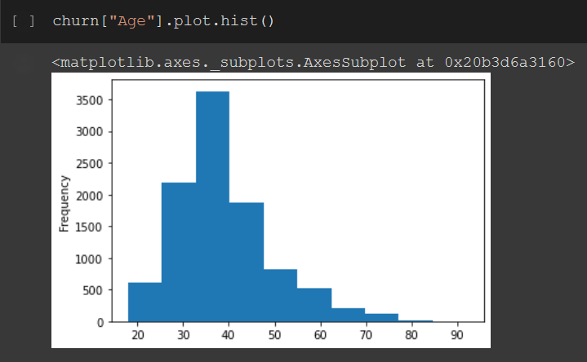
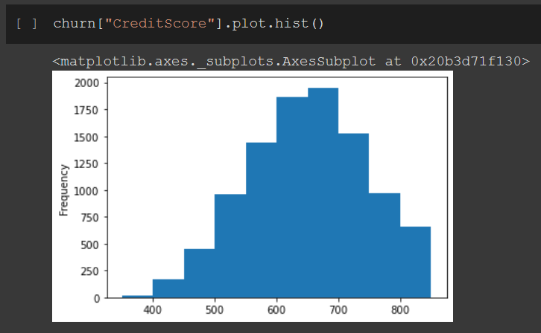
HISTOGRAMS

Slide 18
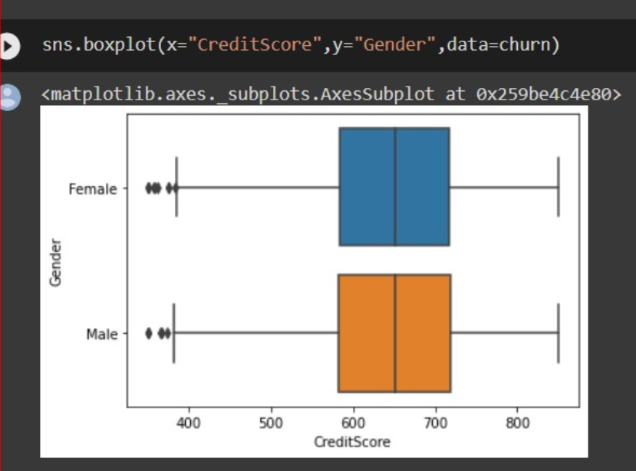
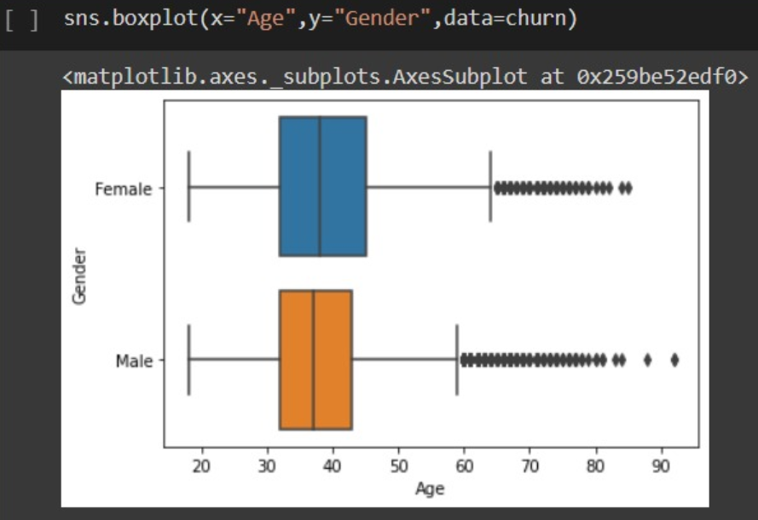
BOXPLOT
Things to note
Most customers lie in the age bracket 25-45
Most people credit score lie in the range of 600-700

Slide 19
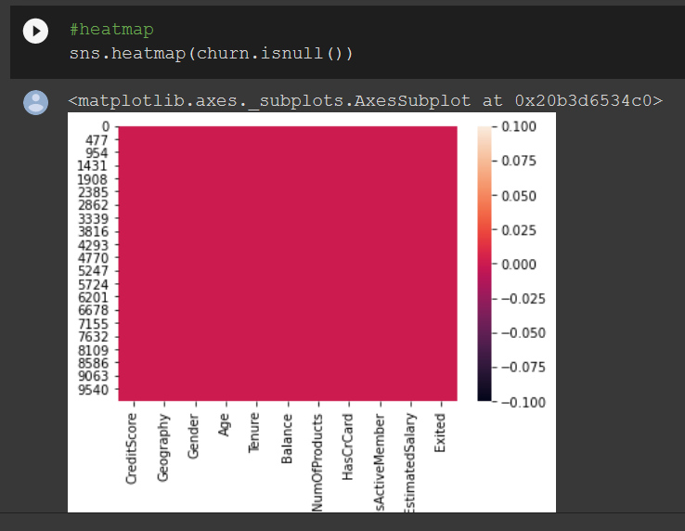
HEAT MAP FOR NULL VALUES

Slide 20
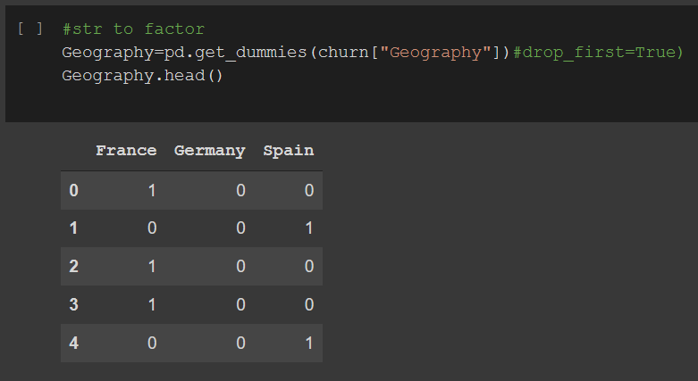
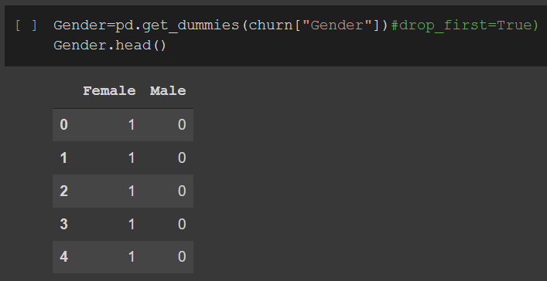
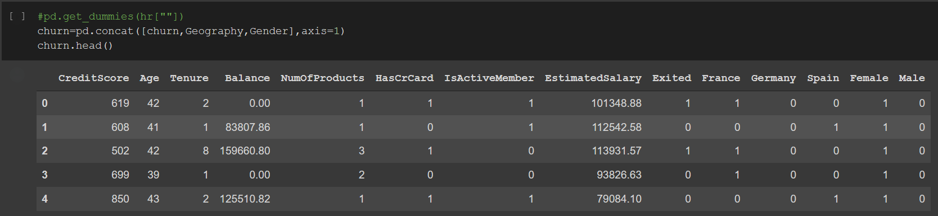
CONVERTING STRINGS TO FACTOR AND CONCATING COLUMNS

Slide 21
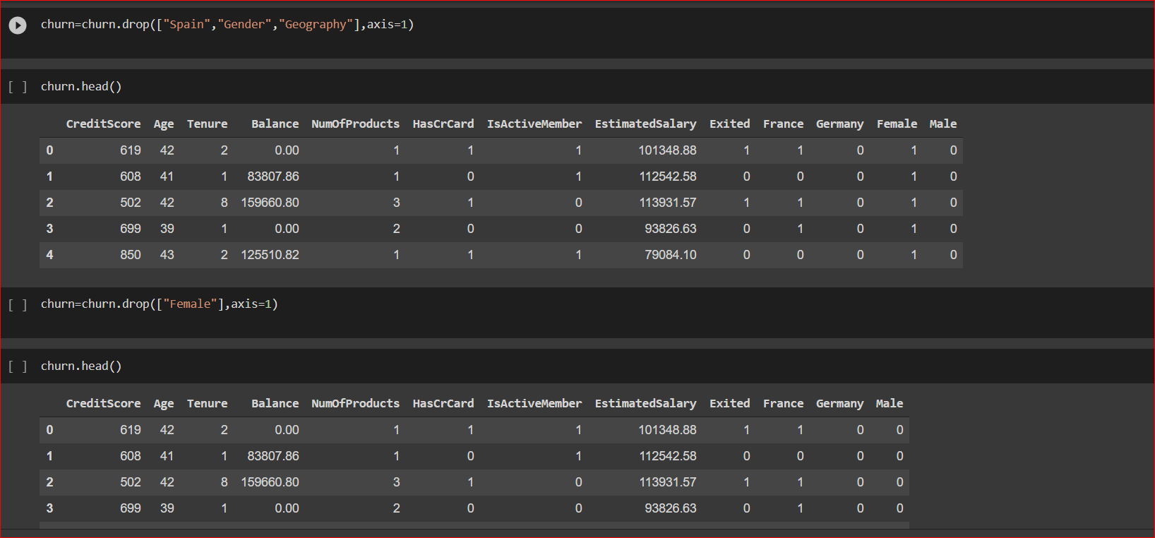
DROPPING COLUMNS

Slide 22
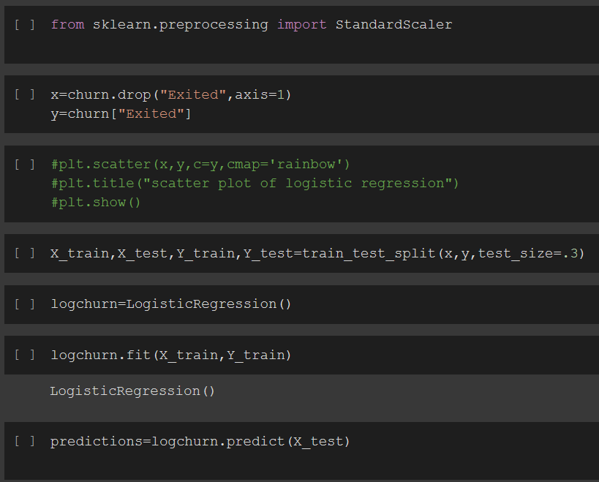
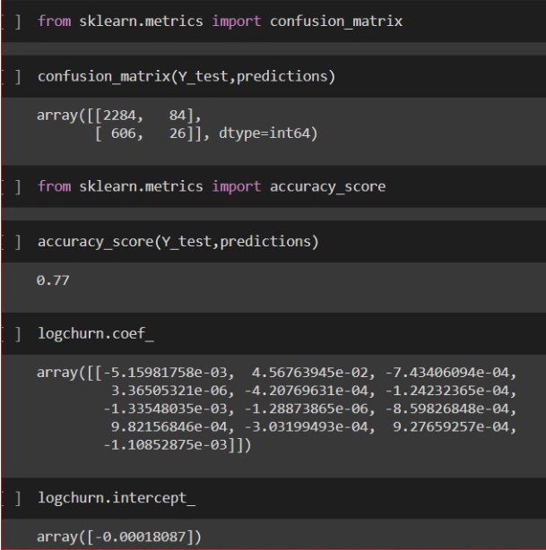
Train & Test

Slide 23
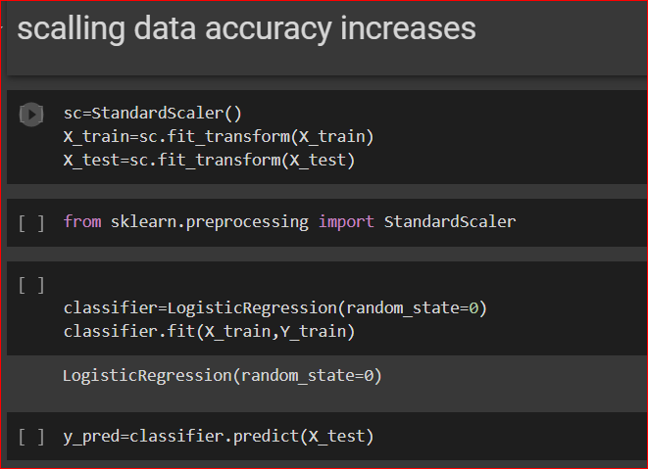
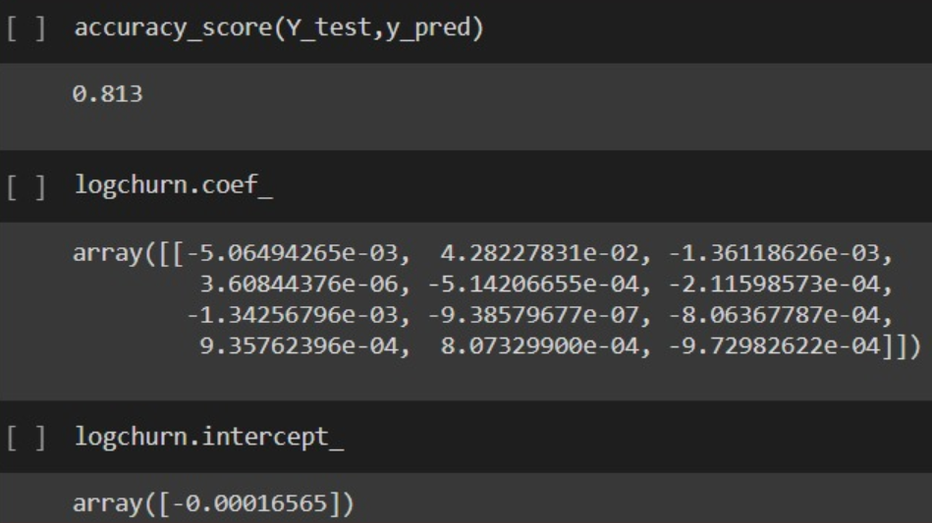
Accuracy after scaling

Slide 24
conclusions
Biggest customer base are the 1025 customers which have been associated with the bank for 8 years
70.55% of the customers do not have credit card & 29.45% have a credit card.
Majority of the customers leaving the bank are from the countries France and Spain. This is Inspite of the fact that the customers from France have the highest participation in the number of products and tenure of association with the bank .
Model is 81.3 % accurate which means that bank will be able to know how many customers are leaving and how many are retained. Talking to customers who are about to change banks and trying to resolve their issues, can help in retaining them

Slide 25



BUSINESS IMPLICATION
As majority of customers are in age 30-50 so bank in order to retain customers can provide facilities like insurance on credit card, free movie tickets or etc benefits to retain customers
Feedback from customers should be taken as why are they leaving and provide facilities according to need of customers
As most of female left the bank ,bank can make its policies such that it is able to retain females by showing them benefits of using cards and others services of bank

Slide 26




Thank You!
Amit Pant
Neha Singhal
https://github.com/nehasinghal9646/churn-rate
https://github.com/amitpant654

